Slide 1
Aventis-University of West London Student Orientation March 2021 Intake

Slide 2
Agenda
Agenda | Time
Registration + Snack Break | 6.30pm
Orientation Briefing by Aventis Staff | 7.00pm – 7.30pm
Academic Writing & Referencing Workshop | 7.30pm – 9.30pm

Slide 3
Aventis - Vision, Mission and Organisation Values
Our Vision
We aim to be the leading provider of quality education in Singapore
Our Mission
We recognize the significance of human capital development and are committed to uphold the quality of teaching, learning and service to all our students

Slide 4
Aventis - Vision, Mission and Organisation Values
Professionalism
Integrity
Customer Care
Communication
Commitment

Slide 5
Student Journey
Orientation
Lesson
Assignment / Examination
Faculty Marking
Academic and Progression Board (APB)
Printing of Certificate & Transcript (3 Months after APB)
Collection of Certificate and Transcript
Moderation
Graduation

Slide 6
Class Attendance
75% overall attendance required
Arrive promptly for classes (No grace period)
Contribute to class discussion
Students are required to sign on the physical attendance register in the classroom when attending classes

Slide 7
Class Schedule
Classroom venue: Please refer to Plasma TV at Aventis campus level 4 on the day of lesson
Lessons are conducted from:
7.00pm to 10.00pm (Fridays)
9.00am to 5.00pm (Weekends)
A copy of the latest updated class schedule can be downloaded from our website: https://aventis.edu.sg/resources/

Slide 8
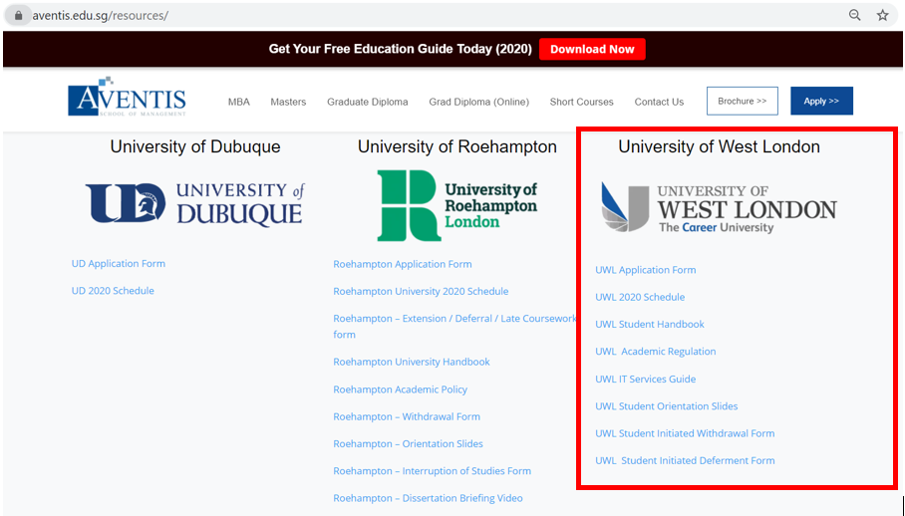
Class Schedule

Slide 9
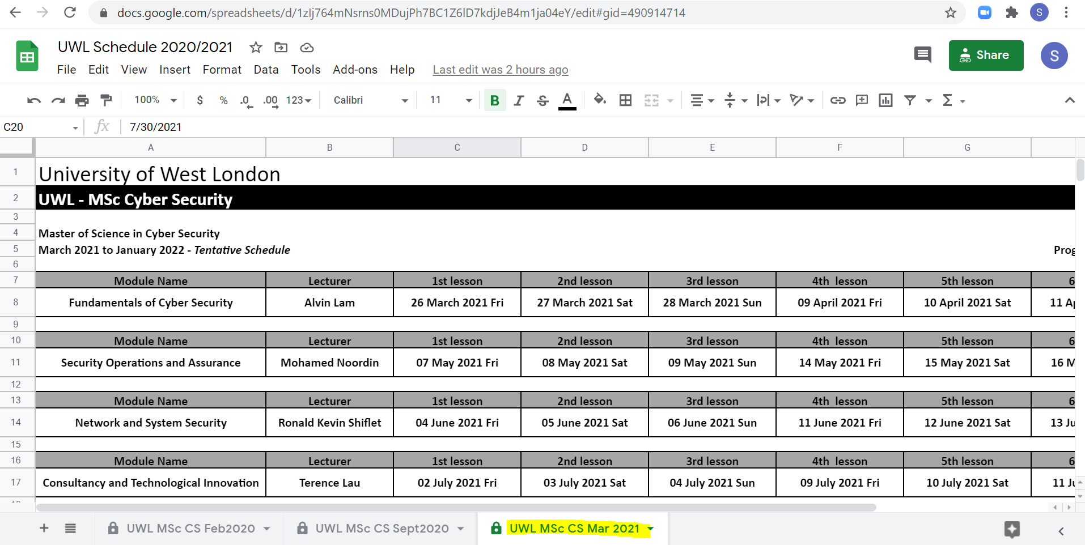
Class Schedule

Slide 10
Leave Application
Student must submit Leave Application Form and supporting document to the student service at studentservices@aventisglobal.edu.sg at least 5 days before the class date or latest within 3 days after the class date.
Following are the valid grounds for leave application approval:
A copy of the leave application form can be downloaded at: https://aventis.edu.sg/resources/

Slide 11
Assessment Component – MSc Cyber Security
Module Title | Credit | Assessment Type | Weightage | Overall pass mark
Fundamentals of Cybersecurity | 20 | Portfolio | 100% | 50
Network & Systems Security | 20 | Written Assignment Written Exam | 50% 50% | 50
Security Operations & Assurance | 20 | Written Assignment Written Exam | 50% 50% | 50
Principles of Project Management | 20 | Written Assignment | 100% | 50
Consultancy and Technological Innovation | 20 | Written Assignment | 100% | 50
Research Methods | 20 | Written Assignment | 100% | 50
Dissertation | 60 | Dissertation | 100% | 50

Slide 12
Assessment – Submission Time
Online assignment submission via Blackboard - Turnitin
Deadline is 15 days after the end of each module lesson
Result release (provisional result) will be reflected on MyRegistry - My Assessments and Blackboard – My Grades after one month of submission due date

Slide 13
Assessment – Late Submission and Extension
Late Submission:
Late up to a maximum of seven days* from the original deadline: the element mark will be capped at pass mark (50%)
Late over seven days* from the original deadline: the piece of work will receive a mark of zero
Late over fourteen days* from the original deadline: the piece of work will be deemed as non-submission
*Including weekends and public holidays

Slide 14
Assessment – Late Submission and Extension
Extension:
Extension request and supporting document must be submitted to studentservices@aventisglobal.edu.sg (Processing time: 5 working days)
Reasons such as work commitments, personal travel, technical hardware issues like computer fault, will not be accepted as valid grounds for assignment extension / deferment.
No formal extension of assignment submission deadline (s) unless it has written approval from the University of West London.

Slide 15
Assessment – Resit & Retakes
50% - Pass the module
If fail the module, next step:
Resits – Re-submission of assignment and/or re-sit for examination
Retakes – Only applicable after failing resit, you will need to do the whole module again.

Slide 16
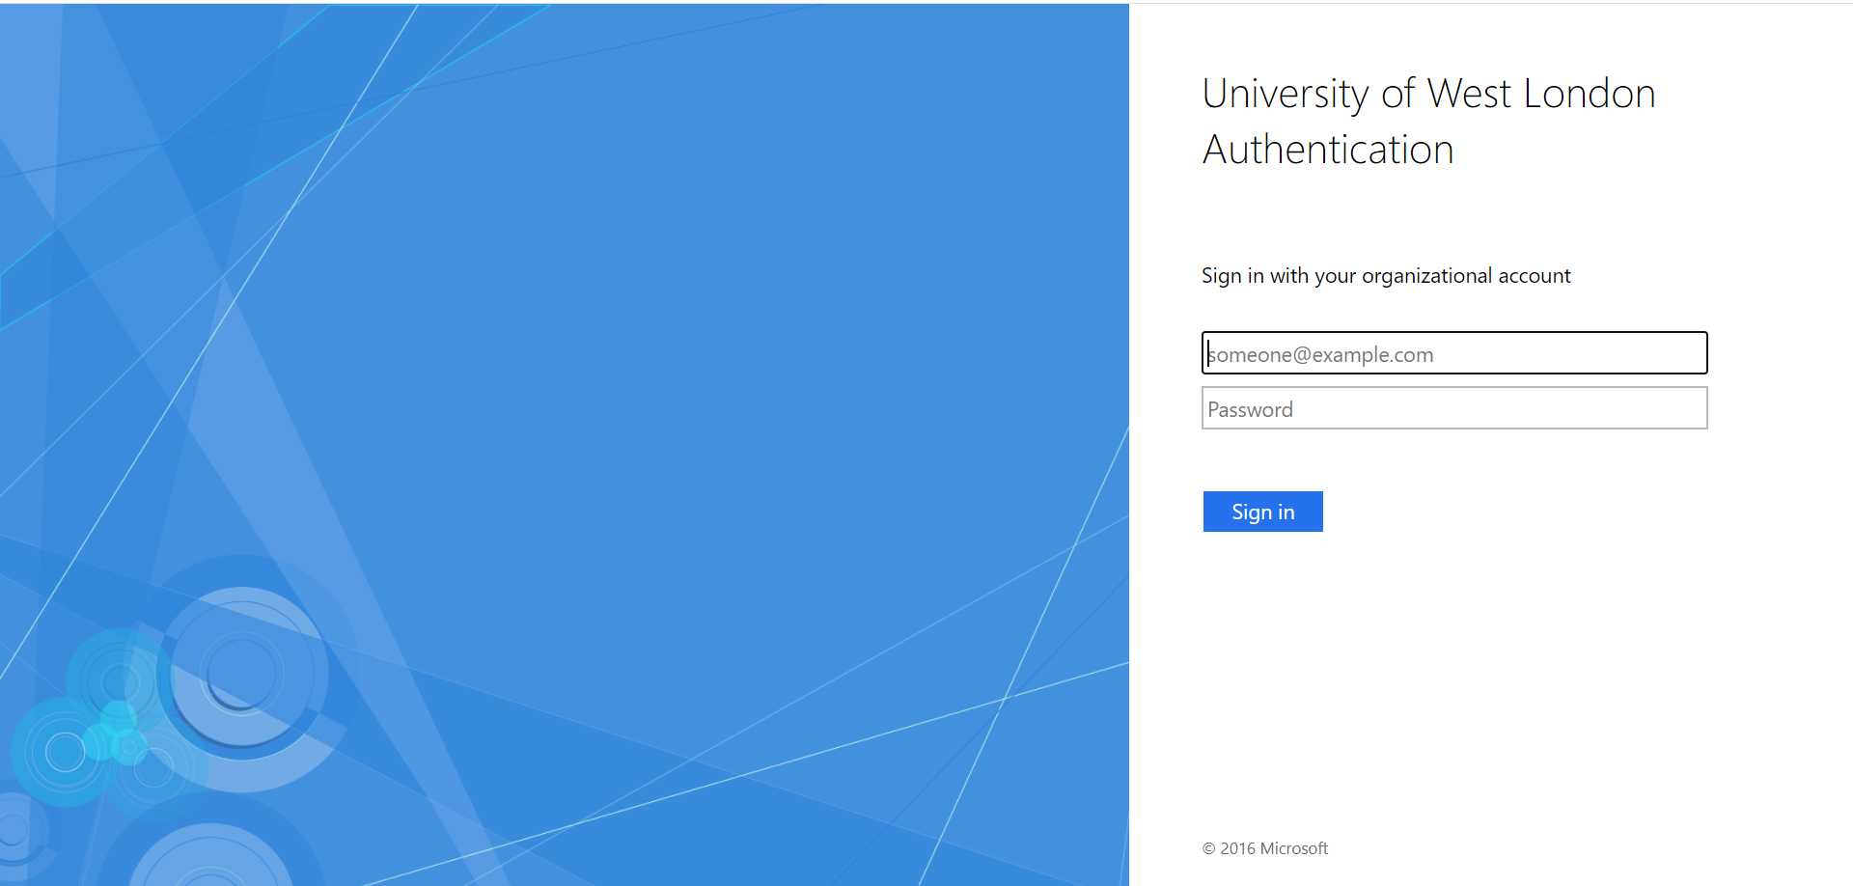
University Learning Management System - Blackboard
Weblink: http://online.uwl.ac.uk

Slide 17
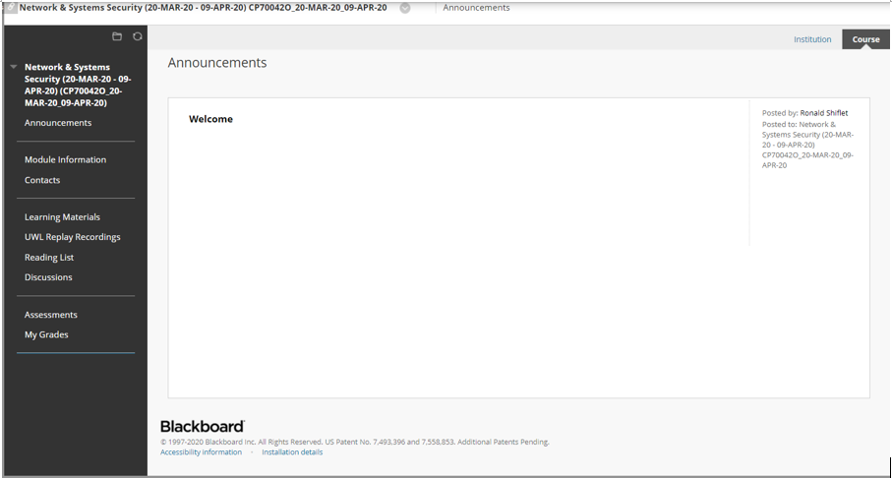
University Learning Management System - Blackboard
Weblink: http://online.uwl.ac.uk

Slide 18
Blackboard Credentials / Study Materials
UWL IT will send the Blackboard credentials in a separate email, do check your inbox / junk mail.
Please try to login into Blackboard once received. You can read the ‘UWL IT Services Guide’ found in https://www.aventis.edu.sg/resources/ for more information.
All class materials are available in Blackboard under ‘Learning Materials’.
For students who have not received their Moodle login details, the course materials have been made available via Google Drive with all the necessary materials in: Fundamentals of Cyber Security

Slide 19
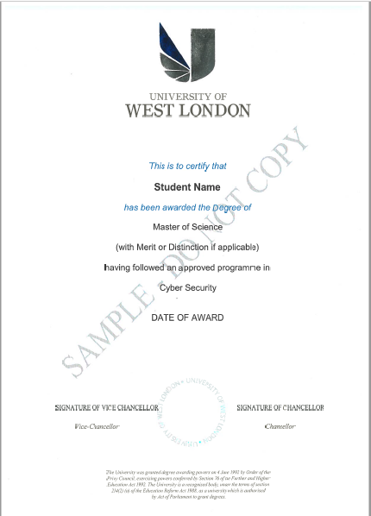
Sample Certificates / Classification of Results
*** Name are printed on certificate and transcripts based on official documents such as NRIC and passports.
On certificates will display the classification based on average mark
Pass: 50% – 59%
Merit: 60% – 69%
Distinction: 70% - 100%
On transcripts, module results will be displayed

Slide 20
School Fees
Please refer to your Student-PEI contract on your school fees
Payment modes:
iBanking/Mobile Banking/ATM transfer (provide screenshot)
Cheque made payable to “Aventis School of Management Pte Ltd”
Cash payment to Aventis full-time staff
Telegraphic Transfer
NETS (3% admin fee applies)
Please email a screenshot of the successful bank transfer email to studentservices@aventisglobal.edu.sg. An official receipt will be emailed to you upon verification of your payment.
Payment reminders will be sent to students 2 weeks before due date. Any LATE payments will incur 5% penalty.

Slide 21
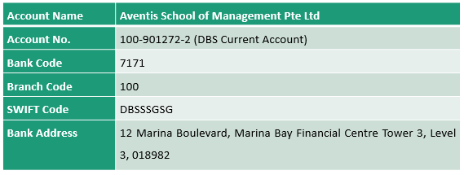
School Fees
Payment of fees should be made in Singapore dollars to following:

Slide 22
Deferment Policy
Student must inform Aventis by writing to student services together with all supporting documents for processing the deferment request.
Student is required to complete ‘UWL Student Initiated Deferment’ to interrupt your programme of study.
Student will be informed of the outcome, within four (4) weeks from the date the request is submitted for processing by the University.
Maximum deferment/interruption period is 1 year.

Slide 23
Withdrawal and Refund Policy
Student must inform Aventis by completing Aventis “Withdrawal and Refund Request Form” and the respective University’s Withdrawal Form together with all supporting documents for processing the withdrawal request
Student will be informed of the outcome, within four (4) weeks from the receipt of the withdrawal application
% of [the aggregate amount of the fees paid under Schedule B of the Student Contract] | If Student’s written notice of withdrawal is received
[100%] | Refer to PEI-Student Contract Clause 2.1
[70%] | (“Maximum Refund”) More than [60] days before the Course Commencement Date
[50%] | Before, but not more than [60] days before the course commencement date
[30%] | Before, but not more than [14] days before the course commencement date
[10%] | Before, but not more than [7] days before the course commencement date
[0%] | On or after the Course Commencement Date

Slide 24
Online Evaluation Form
Link provided to student via email for the online evaluation
Login is not required, hence response will remain strictly anonymous.
Survey can also be found in the Moodle.
Module Survey: http://asm.edu.sg/modulesurvey/
This survey is need to be completed every time after the last class of every module.
Course Survey: http://asm.edu.sg/coursesurvey/
This survey is need to be completed once you finished all 8 modules.

Slide 25
Student Feedback and Grievances
In the event that you have any feedback/concerns/issues, please contact Student Services via email at studentservices@aventisglobal.edu.sg
We will investigate and resolve the areas of concern within 21 working days, depending on the complexity of the case. If a student is not satisfied with the outcome of the resolution process, we may refer the matter concerned to the CPE Mediation-Arbitration Scheme. For more details, please visit https://www.ssg.gov.sg/cpe/student-services/dispute-resolution.html

Slide 26
UWL Student Handbook & Forms

Slide 27
Our Commitment to You
Student Services
Email: studentservices@aventisglobal.edu.sg
(Response within 3 working days)
Telephone: 9466 1697
(Only SMS/WhatsApp after operating hours)
We are located at level 3 office
Operating Hours
Monday to Friday: 9.30am – 6.30pm
Saturday: 8.30am – 12.30pm

Slide 28
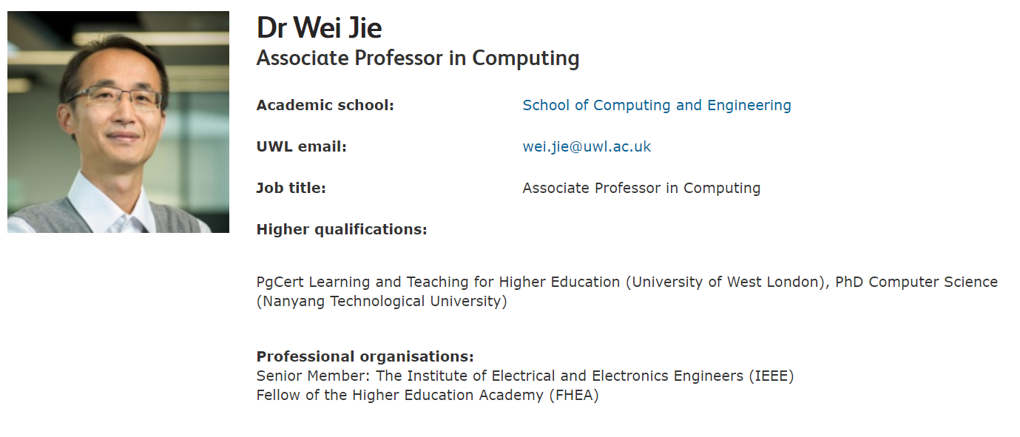
UWL Course Leader

Slide 29
Any questions? Thank you

Slide 30
Academic Writing and Referencing Workshop by Mr Ronald Shiflet

Slide 31
Agenda
Reviewing postgraduate assessment criteria: What do we mean by critical thinking, writing and analysis?
Referencing
How to access essential resources to support your studies
Academic regulations

Slide 32
Modules you will study
Master of Science in Cyber Security
Fundamentals of Cyber Security
Network and System Security
Security Operations and Assurance
Principles of Project Management
Consultancy and Technological Innovation
Research Methods
Dissertation

Slide 33
Ice-breaker

Slide 34
Ice-breaker
ANALYSE YOURSELF AS A UNIVERSITY STUDENT…
2 STRENGTHS
2 WEAKNESSES
2 OPPORTUNITIES
2 THREATS

Slide 35
What is critical thinking?
Critical thinking is:
questioning
inferring
evaluating
analysing
judging
reasoning
(Pd4pic.com, 2015)

Slide 36
What is critical thinking?
“weighing up arguments for and against” (Cottrell, 2008)
“Critical thinking is the intellectually disciplined process of actively and skilfully conceptualizing, applying, analysing, synthesizing, and/or evaluating information gathered from, or generated by, observation, experience, reflection, reasoning, or communication, as a guide to belief and action” (Criticalthinking.org, 2015)

Slide 37
Critical thinking in an academic context
Two key components
A habit of questioning
Specific knowledge
Accepting that there may not be one ‘right’ answer
Acknowledging that Lecturers don’t have all of the answers
A crucial way of showing how you have engaged with your sources (analysis rather than description)

Slide 38
Critical thinking behaviour and principles
Read
Question
Make judgements
Compare and contrast
Be sceptical
Examine
Synthesise
Identify gaps
Reflect
Critique your own ideas

Slide 39
Points to remember with critical writing
Check that you have:
Addressed your task fully
Introduced your work clearly
Organised your ideas effectively
Provided evidence to support your claims
Evaluated the evidence you use
Concluded your work effectively.

Slide 40
Referencing
Referencing involves two key elements:
Citations (Quoting and Paraphrasing)
Bibliography/Cited Works/Reference List

Slide 41
Citations
Paraphrasing
When you include the arguments, ideas, or theories of anyone other than yourself in your work and put them into your own words, this is called paraphrasing. Whenever you paraphrase you need to acknowledge the source you obtained the information from.
For example: Robson and Robson (2015) showed in their research that individual variables were more important than organisational ones.

Slide 42
Quoting
You may be more familiar with this element of referencing. When you include the exact words of someone else’s work in your essay you are quoting. You must indicate that the words you are using are not your own. To do this, use ‘single inverted commas’ around the words you are quoting (“speech marks” are usually used for quoting direct speech).
For example: Robson and Robson (2015: 10) concluded “Predictors of continuation intention in this UK public context display much greater concentration on the individual”.

Slide 43
Presenting your quotations/paraphrasing in your work
Depends on source of reference:
Source | Quotation | Paraphrase
Book with author(s) | (Surname(s), Year: Page no) e.g. Burn and Brunt (2016:18) | (Surname(s), year) e.g. Burn and Brunt (2016)
Journal article
Online journal article
Website | (Surname/Corporate author, Year:Page - if available) e.g. CIPD (2016) | Paraphrase: (Surname/Corporate author, Year) e.g. CIPD (2016)

Slide 44
Bibliography/references list
A bibliography or cited works/reference list is a list at the end of your work that provides full details of each source you have used in your essay in alphabetical order. A bibliography contains all the sources you have consulted for your work, even if you have not made direct mention to them in the text. A cited works/reference list contains only the sources you have cited in the text of your work.

Slide 45
What information do you need to provide in list of references?
Books
Author (Year) Title of Book. (Edition - if not first edition.) Place of Publication: Publisher.
For example:
Gatrell, C. (2005) Managing part-time study: A guide for undergraduates and postgraduates. Milton Keynes: Open University Press

Slide 46
Journal article
Author (Year) Title of article. Title of Journal. Volume(Issue) Pages.
For example:
Siew, Chen, S. & Vinayan, G. (2016) Recruitment process outsourcing: A case study in Malaysia. Personnel Review. 45(5) pp. 1029-1046.

Slide 47
Online journal article
Author (Year) Title of article. Title of Journal. Volume(Issue) Pages. Available at: URL (Accessed: dd/mm/yy).
For example:
Siew, Chen, S. & Vinayan, G. (2016) Recruitment process outsourcing: A case study in Malaysia. Personnel Review. 45(5) pp. 1029-1046. Available at: http://www.emeraldinsight.com/doi/pdfplus/10.1108/PR-10-2012-0172 (Accessed 04/09/16).

Slide 48
Website
Author/Corporate author (Year) Title of Webpage. Available at: URL (Accessed: dd/mm/yy).
For example:
CIPD (2015) Absence measurement and management factsheet. Available at: http://www.cipd.co.uk/hr-resources/factsheets/absence-measurement-management.aspx# (Accessed: 04/09/16)

Slide 49
Plagiarism
Plagiarism occurs when attempting to present another person’s work as your own. When you include the ideas or work of someone else without referencing them, or use the exact words they have used and attempt to present them as your own argument, then this is considered plagiarism. Plagiarism in written work can occur intentionally (e.g. you copy a section from a book without referencing it) or unintentionally (e.g. you paraphrase another person's work or ideas but fail to acknowledge them as the source).

Slide 50
Turnitin – Similarity Index
Similarity Reports provide a summary of matching or highly similar text found in a submitted paper. When a Similarity Report is available for viewing, a similarity score percentage will be made available. Similarity Reports that have not yet finished generating are represented by a grayed-out icon in the Similarity column. Reports that are not available may not have generated yet, or assignment settings may be delaying the generation of the report. Acceptable range is below 25%.
https://help.turnitin.com/feedback-studio/moodle/direct-v2/instructor/the-similarity-report/similarity-score-ranges.htm

Slide 51
Turnitin – Similarity reports
Reports for the FIRST THREE submissions to a Turnitin assignment link will normally generate within 5-15 minutes.
However, for re-submissions to the same Turnitin assignment link, the report will take at least 24 hours to generate. This includes the Turnitin test sites.
https://help.turnitin.com/feedback-studio/moodle/direct-v2/instructor/the-similarity-report/similarity-score-ranges.htm

Slide 52
Your homework and further support:
Access and read the following chapter 2 on postgraduate study skills prepared by CIPD - https://goo.gl/RBvmFC

Slide 53
How to be a successful student
Attend all of the classes
Prepare for every class – consult your LTAF for what you should read and do
Engage in all of your classes – ask questions and share your answers
Use your work experience to bring theory to life
Don’t leave your assignments until the last minute
Learn from each other and previous sample assignments
Read, read, read – focus on journals

Slide 54
Accessing resources
Moodle site for every module
Lesson plan
Presentation slides
Seminar activities
Links to electronic journals and eBooks
You may independently organise to use local libraries in Singapore

Slide 55
Excerpts from academic regulations
Submission of work for assessment
A part-time student must submit to assessment for all the modules on which they are enrolled for each academic year of their course.
In order to be regarded as having submitted to assessment a student must have either:
Undergone the final assessment of the module; or
Passed the module, where this can be achieved without undergoing the final assessment.
Failure to submit to assessment is considered a Non-Submission.
Academic Regulations AY19/20

Slide 56
How will we help you with your assessments?
Share assessments at the start of each module
Clear assessment briefs
Marking criteria provided for every module
Formative feedback activities to check your understanding
Feedback on a one page overview of your assignment plan
Opportunity to ask questions

Slide 57
Recap: Key messages
Read, read, read
Journal articles are essential
Engage in team/group activities – learn from each other
Directed study will help you to make the most out of lectures/seminars
Critical evaluation is key (link to benchmark standards)
50% = pass, 70% = distinction (different from US system)
Make the most out of formative feedback

Slide 58
Your are the Master of Your Game
Q&A

