Slide 1

Welcome to Aventis - University of Roehampton
ORIENTATION
July 2021 Intake

Slide 2
Agenda
Agenda | Time
Orientation Briefing by Aventis Staff | 7.00pm – 7.30pm
Academic Referencing Workshop by Mr Ronald Shiflet | 7.30pm – 9.30pm

Slide 3
Welcome to Aventis School of Management
Our Vision
We aim to be the leading provider of quality education in Singapore
Our Mission
We recognize the significance of human capital development and are committed to uphold the quality of teaching, learning and service to all our students

Slide 4
Our Organization Values
Professionalism
Integrity
Customer Care
Communication
Commitment

Slide 5
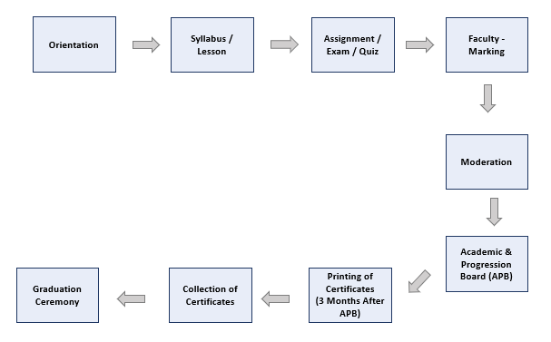
Student Journey

Slide 6

Class Attendance
75% overall attendance recommended
Arrive promptly for classes (No grace period)
Contribute to class discussion
Class will be conducted via Zoom

Slide 7

Class Schedule
Each module – 4 lessons per month, please refer to programme schedule
Lessons are conducted from:
9.00am to 5.00pm (Weekends)
A copy of the latest updated class schedule can be downloaded from our website: https://aventis.edu.sg/resources/

Slide 8
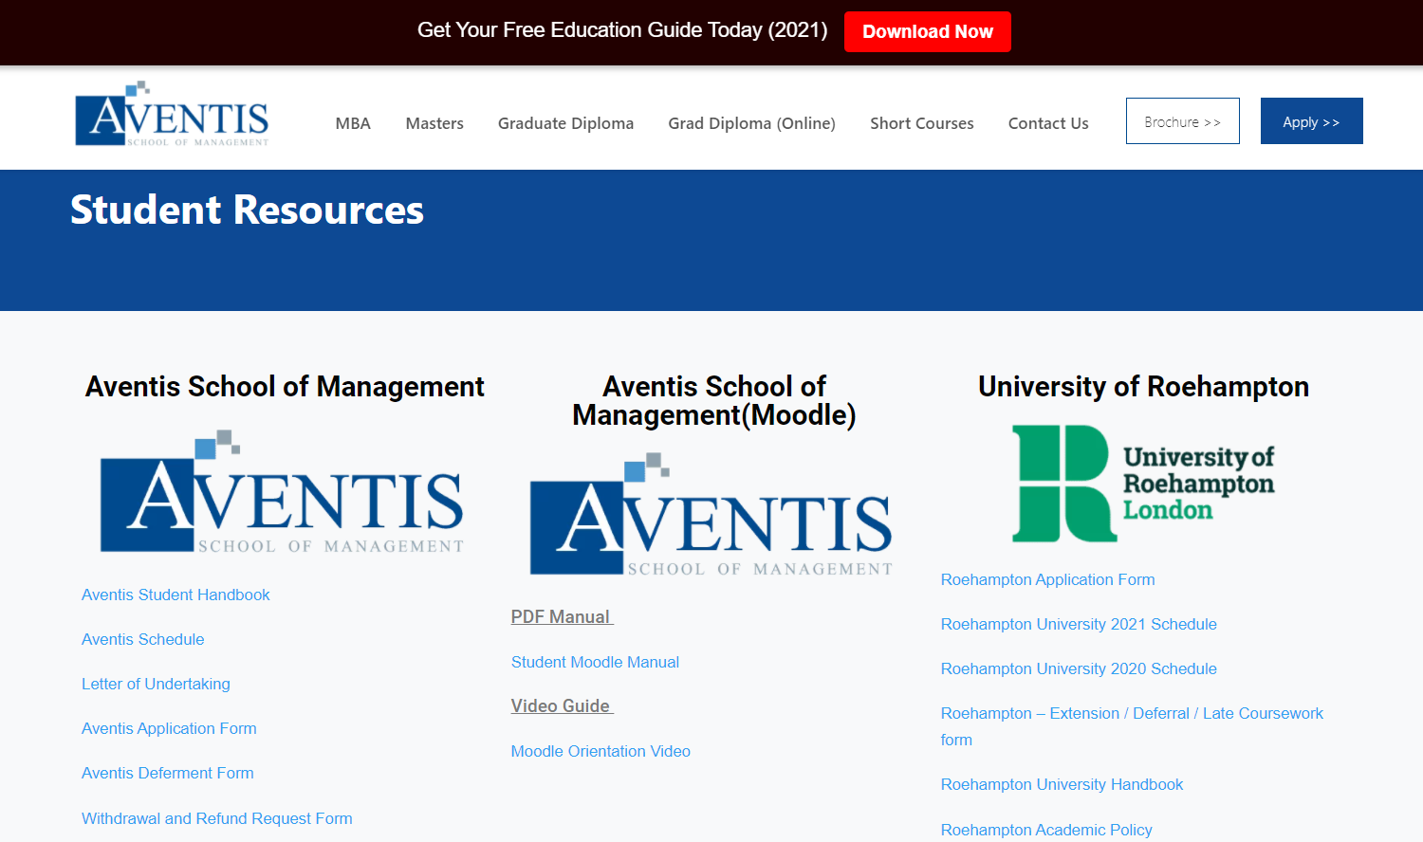
Class Schedule

Slide 9
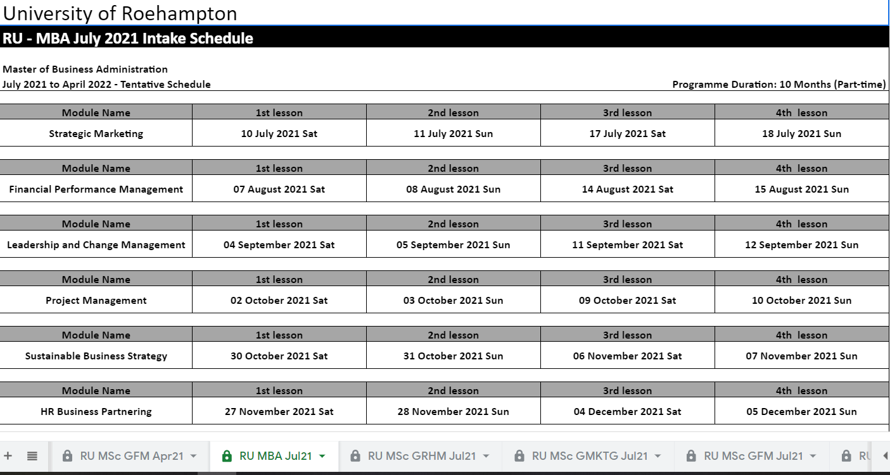
Class Schedule

Slide 10

University Learning Platform – Moodle
Weblink: https://partnerships.moodle.roehampton.ac.uk/login/index.php

Slide 11
Change of Personal Details on Moodle
Weblink: https://partnerships.moodle.roehampton.ac.uk/login/index.php
Personal details that could be changed includes the following:
Address
Contact Details such as email address & contact number
Any name changes must be submitted via FORM SR7 (Application to change name) with supporting documents.

Slide 12
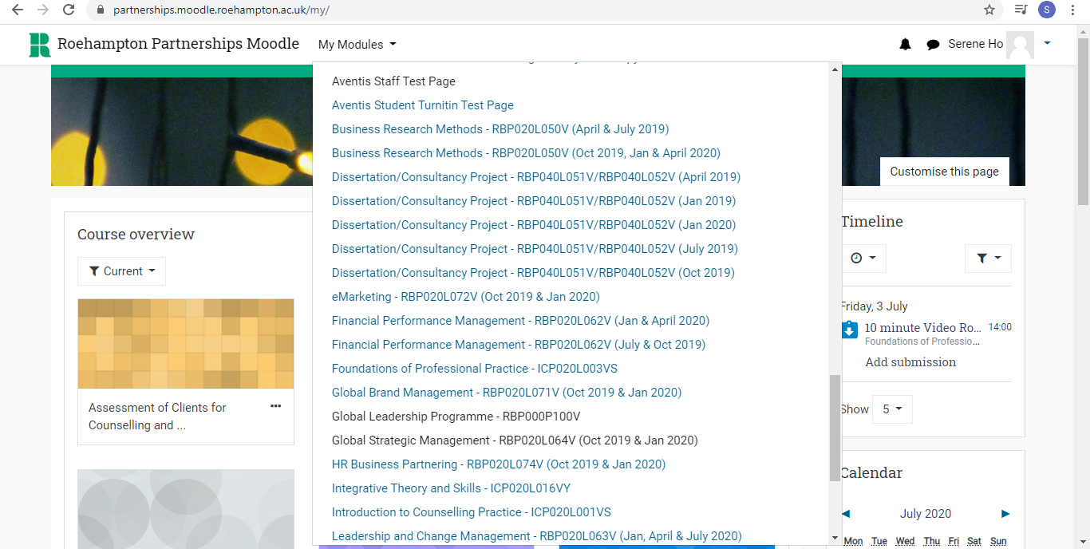
University Learning Platform – Moodle
Student Turnitin Test Page

Slide 13

University Online Library
Roehampton Online Library
  Access it from the footer of your Moodle page and sign in with your Roehampton email address and password when prompted

Slide 14
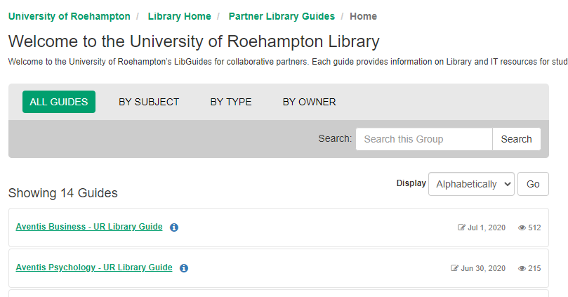
University Online Library
Roehampton Online Library
  Click on Library guides as shown to access the online library resources

Slide 15
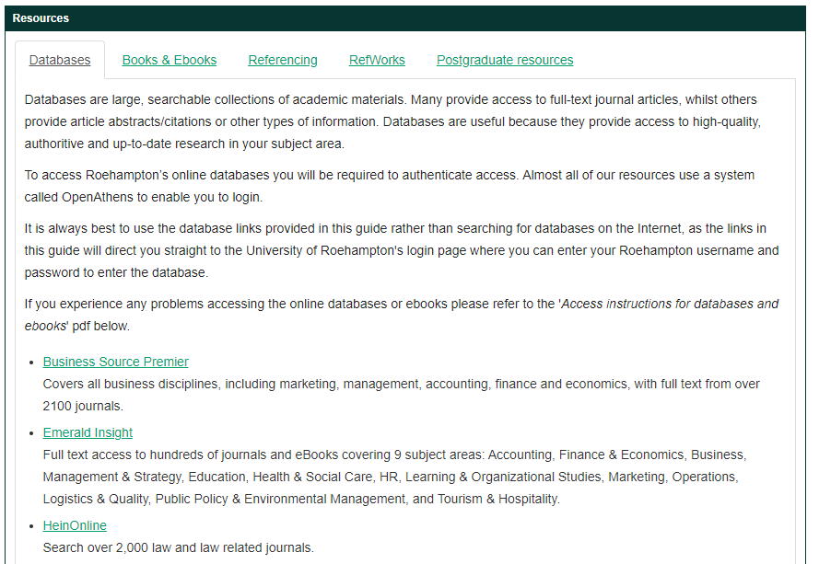

Slide 16
Study Materials
For students who have not received their Moodle login details, the course materials have been made available via Google Drive with all the necessary materials in.

Slide 17
Assignment Deadlines
15 days from the date of last class
  10pm SG time
Any extensions is strictly at the discretion of the University
Extension request to be submitted at least 3 working days prior to the deadline
Reasons such as the following are not valid grounds for an extension request:
  Work commitments
  Failure to attend class
  Computer failure/ technical issue
  Outstation for work

Slide 18
Late Submissions
Penalty will be imposed on work that is submitted after the stipulated deadline
Penalties are as follows:
  For submissions up to 10pm (SG time), seven calendar days after deadline; grades will be capped at 50%
  For submission after 10pm (SG time), seven calendar days after the deadline; the assessment will be set to zero

Slide 19
Extension Requests
Extension request and supporting document must be submitted to studentservices@aventisglobal.edu.sg (Processing time: 3 working days)
Reasons such as work commitments, personal travel, technical hardware issues like computer fault, will not be accepted as valid grounds for assignment extension / deferment.
No formal extension of assignment submission deadline (s) unless it has written approval from Aventis.

Slide 20
Provisional Results
Provisional results of assignments will be released on Moodle one month after the assignment due date.
Actual results of assignment will be confirmed during the University’s Exam board which are scheduled to take place quarterly.
Students will be informed of any resits/ retakes if required.

Slide 21
Re-sits & Retakes
Student who has failed their module assessment on the first attempt will be permitted to one re-sit opportunity, without further study
  Re-sit fee of $535 will be applicable
Re-module (Retakes) will be required should students fail their re-sit attempts
  Re-module fee will be applicable accordingly as per your student contract

Slide 22
Classification of Results
On transcripts, module results will only display Pass/Fail
On certificates will display the classification based on average mark
Pass: 50% – 59%
Merit: 60% – 69%
Distinction: 70% - 100%

Slide 23
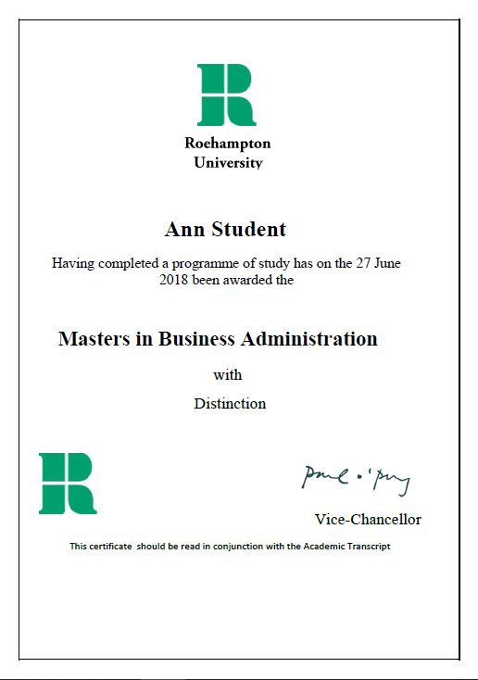
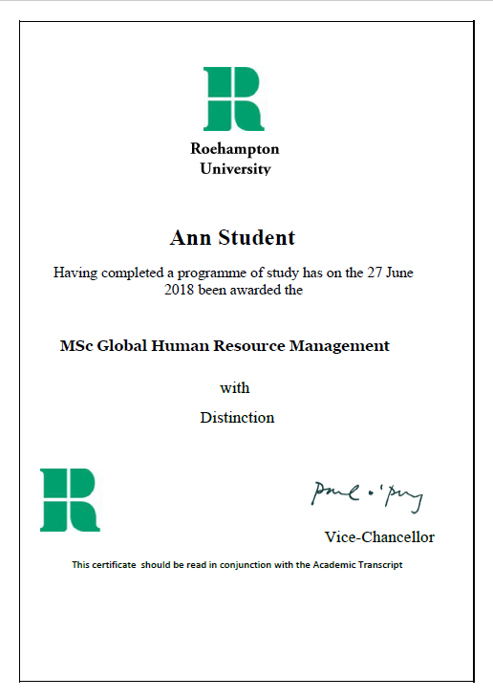
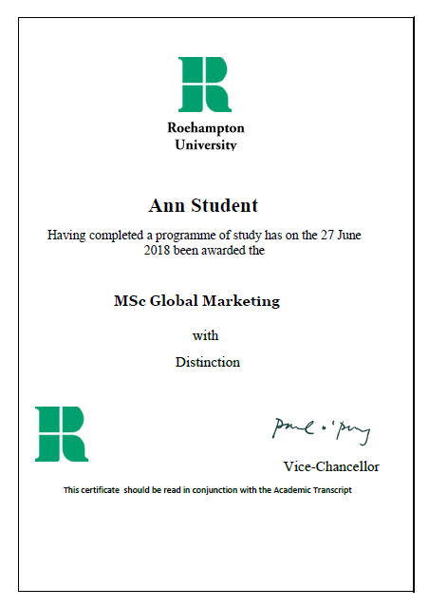
Sample Certificates
*** Name are printed on certificate and transcripts based on official documents such as NRIC and passports.

Slide 24
Sample Certificates
Follows the UK Naming Convection
Certificate Naming Convection :
Forename followed by Last Name
Example 1: Wei Liang Tan
Wei Liang (forename) & Tan (Last name)
Transcripts Naming Convection:
Last Name, Forename
Example 1: Wei Liang Tan
Tan, Wei Liang

Slide 25
Sample Certificates
Follows the UK Naming Convection
Certificate Naming Convection:
Forename followed by Last Name
Example 2: Clare Andrews
Clare (forename) & Andrews (Last name)
Transcripts Naming Convection:
Last Name, Forename
Example 2: Clare Andrews
Andrews, Clare

Slide 26
Sample Certificates
Follows the UK Naming Convection
Certificate Naming Convection:
Forename followed by Last Name
Example 3: Clare Michelle Andrews
Clare Michelle(forename) & Andrews (Last name)
Transcripts Naming Convection:
Last Name, Forename
Example 3: Clare Michelle Andrews
Andrews, Clare Michelle

Slide 27
Sample Certificates
Follows the UK Naming Convection
Certificate Naming Convection:
Forename followed by Last Name
Example 4: Nurul Aqilah Binte Sari Nurul Aqilah (forename) & Binte Sari (Last name)
Transcripts Naming Convection:
Last Name, Forename
Example 4: Nurul Aqilah Binte Sari
Binte Sari, Nurul Aqilah

Slide 28
Sample Certificates
Follows the UK Naming Convection
Certificate Naming Convection:
Forename followed by Last Name
Example 5: Murugayan S/O Kalimuthu Murugayan (forename) & S/O Kalimuthu (Last name)
Transcripts Naming Convection:
Last Name, Forename
Example 5: Murugayan S/O Kalimuthu
S/O Kalimuthu, Murugayan

Slide 29
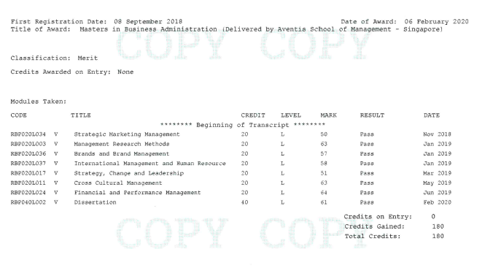
Sample Transcript

Slide 30
School Fees
Please refer to your Student-PEI contract on your school fees
Payment modes:
  iBanking/Mobile Banking (provide screenshot)
  Cheque made payable to “Aventis School of Management Pte Ltd”
  Cash payment to Aventis full-time staff
  Telegraphic Transfer
  NETS (3% admin fee applies)
Please email a screenshot of the successful bank transfer email to studentservices@aventisglobal.edu.sg. An official receipt will be emailed to you upon verification of your payment.
Payment reminders will be sent to students 2 weeks before due date. Any LATE payments will incur 5% penalty.

Slide 31
School Fees
Payment of fees should be made in Singapore dollars to following:
Account Name | Aventis School of Management Pte Ltd
Account No. | 100-901272-2 (DBS Current Account)
Bank Code | 7171
Branch Code | 100
SWIFT Code | DBSSSGSG
Bank Address | 12 Marina Boulevard, Marina Bay Financial Centre Tower 3, Level 3, 018982

Slide 32
Leave Application
Student must submit Leave Application Form and supporting document to the student service at studentservices@aventisglobal.edu.sg at least 5 days before the class date or latest within 3 days after the class date.
Following are the valid grounds for leave application approval:
Reasons | Supporting Documents (in English Language)
Compassionate Leave for Immediate family members | Death Certificate
Medical Leave | Medical Certificate
Business Overseas Trip | Company Letter and Air Ticket/Boarding Pass
A copy of the leave application form can be downloaded at: https://aventis.edu.sg/resources/

Slide 33
Deferment Policy
Student must inform Aventis by writing to student services together with all supporting documents for processing the deferment request.
Student is required to complete the SR5 - Application to interrupt your programme of study.
Student will be informed of the outcome, within four (4) weeks from the date the request is submitted for processing by the University.
Maximum deferment/interruption period is 1 year.

Slide 34
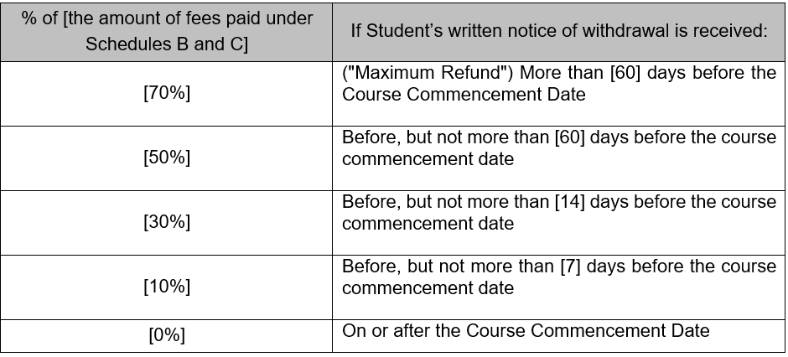
Withdrawal and Refund Policy
Withdrawal
Student must inform Aventis by completing Aventis “Withdrawal and Refund Request Form” and the respective University’s Withdrawal Form together with all supporting documents for processing the withdrawal request
Student will be informed of the outcome, within four (4) weeks from the receipt of the withdrawal application
https://aventis.edu.sg/student-policy-for-edp/

Slide 35

Online Evaluation Form
Link provided to student via email for the online evaluation
Login is not required, hence response will remain strictly anonymous.
Survey can also be found in the Moodle.
Module Survey: http://asm.edu.sg/modulesurvey/
  This survey is need to be completed every time after the last class of every module.
Course Survey: http://asm.edu.sg/coursesurvey/
  This survey is need to be completed once you finished all 8 modules.

Slide 36

Student Feedback and Grievances
In the event that you have any feedback/concerns/issues, please contact Student Services via email at studentservices@aventisglobal.edu.sg
We will investigate and resolve the areas of concern within 21 working days, depending on the complexity of the case. If a student is not satisfied with the outcome of the resolution process, we may refer the matter concerned to the CPE Mediation-Arbitration Scheme. For more details, please visit https://www.ssg.gov.sg/cpe/student-services/dispute-resolution.html

Slide 37

Our Commitment to You
Student Services
Email: studentservices@aventisglobal.edu.sg
Telephone: 6822 2050 (Level 3 office)
WhatsApp: 9866 1138 (Text only)
**Please save the number so that you will be able to receive the WhatsApp broadcast messages from us.**
Response Time / Working Hours
Within 3 working days
Weekdays: 9.30am – 6.30pm
Saturday: 8.30am – 12.30pm

Slide 38
Any questions?
Thank you

Slide 39
Academic Writing and Referencing Workshop
Ronald Shiflet
Aventis Faculty
Aventis School of Management

Slide 40
Agenda
Introduction to Roehampton, your programme and each other
Ice-breaker
Reviewing postgraduate assessment criteria: What do we mean by critical thinking, writing and analysis?
Referencing
How to access essential resources to support your studies
Academic regulations
How to be a successful Roehampton student

Slide 41


About Roehampton
Roehampton is most research-intensive modern university in UK

Slide 42

Vision and values
Collegiality, Equality, Diversity, Global Outlook
Challenging, Inspiring & Supportive of students
Notes:
A belief in the power of education to:
‘transform lives and communities’

Slide 43
Modules you will study
Master of Business Administration | MSc in Global Human Resource Management | MSc in Global Marketing | MSc in Global Financial Management
Business Research Methods | Business Research Methods | Business Research Methods | Business Research Methods
Strategic Marketing | Strategic Marketing | Strategic Marketing | Strategic Marketing
Financial Performance Management | Financial Performance Management | Financial Performance Management | Financial Performance Management
Leadership and Change Management | Leadership and Change Management | Leadership and Change Management | Leadership and Change Management
Sustainable Business Strategy | Managing Across Borders | E-Marketing | Strategic Investment Appraisal
Project Management | Global Strategic Management | Global Strategic Management | Global Strategic Management
HR Business Partnering | HR Business Partnering | Global Brand Management | International Corporate Finance
Dissertation OR Consultancy Project

Slide 44
Ice-breaker

Slide 45


What is critical thinking?
Critical thinking is:
inferring
questioning
evaluating
judging
analysing
reasoning
(Pd4pic.com, 2015)

Slide 46
What is critical thinking?
“weighing up arguments for and against” (Cottrell, 2008)
“Critical thinking is the intellectually disciplined process of actively and skilfully conceptualizing, applying, analysing, synthesizing, and/or evaluating information gathered from, or generated by, observation, experience, reflection, reasoning, or communication, as a guide to belief and action” (Criticalthinking.org, 2015)

Slide 47
Critical thinking in an academic context
Two key components
  A habit of questioning
  Specific knowledge
Accepting that there may not be one ‘right’ answer
Acknowledging that Tutors don’t have all of the answers
A crucial way of showing how you have engaged with your sources (analysis rather than description)

Slide 48
Critical thinking behaviour and principles
Read
Question
Make judgements
Compare and contrast
Be sceptical
Examine
Synthesise
Identify gaps
Reflect
Critique your own ideas

Slide 49
Points to remember with critical writing
Check that you have:
Addressed your task fully
Introduced your work clearly
Organised your ideas effectively
Provided evidence to support your claims
Evaluated the evidence you use
Concluded your work effectively.

Slide 50
Referencing
Referencing involves two key elements:
Citations (Quoting and Paraphrasing)
Bibliography/Cited Works/Reference List
Access the full guide at:
https://library.roehampton.ac.uk/ld.php?content_id=32542499

Slide 51
Citations
Paraphrasing
When you include the arguments, ideas, or theories of anyone other than yourself in your work and put them into your own words, this is called paraphrasing. Whenever you paraphrase you need to acknowledge the source you obtained the information from.
For example: Robson and Robson (2015) showed in their research that individual variables were more important than organisational ones.
Access the full guide at:
https://library.roehampton.ac.uk/ld.php?content_id=32542499

Slide 52
Quoting
You may be more familiar with this element of referencing. When you include the exact words of someone else’s work in your essay you are quoting. You must indicate that the words you are using are not your own. To do this, use ‘single inverted commas’ around the words you are quoting (“speech marks” are usually used for quoting direct speech).
For example: Robson and Robson (2015: 10) concluded “Predictors of continuation intention in this UK public context display much greater concentration on the individual”.
Access the full guide at:
https://library.roehampton.ac.uk/ld.php?content_id=32542499

Slide 53
Presenting your quotations/paraphrasing in your work
Depends on source of reference:
Source | Quotation | Paraphrase
Book with author(s) | (Surname(s), Year: Page no) e.g. Burn and Brunt (2016:18) | (Surname(s), year) e.g. Burn and Brunt (2016)
Journal article
Online journal article
Website | (Surname/Corporate author, Year:Page - if available) e.g. CIPD (2016) | Paraphrase: (Surname/Corporate author, Year) e.g. CIPD (2016)
Access the full guide at:
https://library.roehampton.ac.uk/ld.php?content_id=32542499

Slide 54
Bibliography/references list
A bibliography or cited works/reference list is a list at the end of your work that provides full details of each source you have used in your essay in alphabetical order. A bibliography contains all the sources you have consulted for your work, even if you have not made direct mention to them in the text. A cited works/reference list contains only the sources you have cited in the text of your work.
Access the full guide at:
https://library.roehampton.ac.uk/ld.php?content_id=32542499

Slide 55
What information do you need to provide in list of references?
Books
Author (Year) Title of Book. (Edition - if not first edition.) Place of Publication: Publisher.
For example:
Gatrell, C. (2005) Managing part-time study: A guide for undergraduates and postgraduates. Milton Keynes: Open University Press
Access the full guide at:
https://library.roehampton.ac.uk/ld.php?content_id=32542499

Slide 56
Journal article
Author (Year) Title of article. Title of Journal. Volume(Issue) Pages.
For example:
Siew, Chen, S. & Vinayan, G. (2016) Recruitment process outsourcing: A case study in Malaysia. Personnel Review. 45(5) pp. 1029-1046.
Access the full guide at:
https://library.roehampton.ac.uk/ld.php?content_id=32542499

Slide 57
Online journal article
Author (Year) Title of article. Title of Journal. Volume(Issue) Pages. Available at: URL (Accessed: dd/mm/yy).
For example:
Siew, Chen, S. & Vinayan, G. (2016) Recruitment process outsourcing: A case study in Malaysia. Personnel Review. 45(5) pp. 1029-1046. Available at: http://www.emeraldinsight.com/doi/pdfplus/10.1108/PR-10-2012-0172 (Accessed 04/09/16).
Access the full guide at:
https://library.roehampton.ac.uk/ld.php?content_id=32542499

Slide 58
Website
Author/Corporate author (Year) Title of Webpage. Available at: URL (Accessed: dd/mm/yy).
For example:
CIPD (2015) Absence measurement and management factsheet. Available at: http://www.cipd.co.uk/hr-resources/factsheets/absence-measurement-management.aspx# (Accessed: 04/09/16)
Access the full guide at:
https://library.roehampton.ac.uk/ld.php?content_id=32542499

Slide 59
Plagiarism
Plagiarism occurs when attempting to present another person’s work as your own. When you include the ideas or work of someone else without referencing them, or use the exact words they have used and attempt to present them as your own argument, then this is considered plagiarism. Plagiarism in written work can occur intentionally (e.g. you copy a section from a book without referencing it) or unintentionally (e.g. you paraphrase another person's work or ideas but fail to acknowledge them as the source).
Access the full guide at:
https://library.roehampton.ac.uk/ld.php?content_id=32542499

Slide 60
Turnitin – Similarity Index
Similarity Reports provide a summary of matching or highly similar text found in a submitted paper. When a Similarity Report is available for viewing, a similarity score percentage will be made available. Similarity Reports that have not yet finished generating are represented by a grayed out icon in the Similarity column. Reports that are not available may not have generated yet, or assignment settings may be delaying the generation of the report. Acceptable range is below 20%.
Access the full guide at:
https://roehamptonlearning.com/eLearningServices/help-guides/turnitin
https://help.turnitin.com/feedback-studio/moodle/direct-v2/instructor/the-similarity-report/similarity-score-ranges.htm

Slide 61
Turnitin – Similarity reports
Reports for the FIRST THREE submissions to a Turnitin assignment link will normally generate within 5-15 minutes.
However, for re-submissions to the same Turnitin assignment link, the report will take at least 24 hours to generate. This includes the Turnitin test sites.
Access the full guide at:
https://roehamptonlearning.com/eLearningServices/help-guides/turnitin
https://help.turnitin.com/feedback-studio/moodle/direct-v2/instructor/the-similarity-report/similarity-score-ranges.htm

Slide 62
How to be a successful student
Attend all of the classes
Prepare for every class – consult your LTAF for what you should read and do
Engage in all of your classes – ask questions and share your answers
Use your work experience to bring theory to life
Don’t leave your assignments until the last minute
Learn from each other and previous sample assignments
Read, read, read – focus on journals

Slide 63
Accessing resources
Moodle site for every module
  LTAF plan
  Presentation slides
  Seminar activities
  Links to electronic journals and eBooks
You may independently organise to use local libraries in Singapore

Slide 64
Excerpts from academic regulations
Submission of work for assessment
Except for the provisions of Section 17, students are expected to submit all work for assessment at the first scheduled opportunity after registering for a given module.
There will be a penalty on work which is submitted after the deadline, or after the revised deadline in the case of a student who has been granted an extension under the provisions of Section 16, as follows.
  Where the student submits work up to 2pm, seven calendar days after the deadline, the percentage mark for the component of assessment will be capped at 40% for foundation year modules and all undergraduate modules at Levels 4–6, and at 50% for modules at Level 7.
  Where the student submits work after 2pm, seven calendar days after the deadline, the percentage mark for the component of assessment will be set to zero.
https://www.roehampton.ac.uk/globalassets/documents/quality-and-standards/april-2020/taught-degree-regulations-2019-20.pdf

Slide 65
Grading System
Module assessment
(iii) For modules at Level 7, an outcome of Pass with a percentage mark will be recorded where the student has gained a mark of 50% or above overall and in any components of the module assessment that carry an individual pass requirement. The Programme Examinations Board may condone a mark in the range 40–49% in a component of the module assessment that carries an individual pass requirement if it is satisfied that the student has achieved the learning outcomes for the module and the student has nonetheless gained a mark of 50% or above overall.
(iv) For modules at Level 7, an outcome of Fail with a percentage mark will be recorded where the student has gained a mark of 49% or below overall, or in any components of the module assessment that carry an individual pass requirement subject to the provisions of (iii).

Slide 66
Resits and Retakes
The Programme Examinations Board will confirm a student’s eligibility for a resit of a component of assessment that has been failed or retake of a module.
(i) A resit is defined as an additional attempt of an assessment without attendance.
(ii) A retake is defined as a re-study of the module with attendance, including the completion of all assessments for that module.
A student who has failed the module assessment overall on the first attempt will normally be permitted one opportunity to resit the failed components of the module assessment, without further study, subject to availability.

Slide 67
Resits and Retakes
There will be a penalty on resitting the assessment of a failed module, unless the Programme Examinations Board determines that the student may resit without penalty under the provisions of the Mitigating Circumstances Policy.
The percentage mark for each previously-failed component of the module assessment, rather than for the module overall, will be capped at 50% for modules at Level 7.
A student whose academic performance has been, or is likely to be, impaired because of ill health or other significant reasons may ask for this to be considered by the Programme Examinations Board under the provisions of the Mitigating Circumstances Policy.

Slide 68
Extensions to assessment deadlines
A student may apply on grounds of mitigating circumstances for an extension to the deadline for assessment in one or more components of a particular module. The maximum period of extension available is two weeks and the application must be made before the time of submission.
The extension may only be granted where the mitigating circumstances and supporting evidence are judged to be sufficient

Slide 69
Assessment and feedback
What happens to your work?
Stage One
Stage Two
Stage Three
Stage Four
Stage 5
Stage 6
Checking consistency in marks and feedback (internal)
Sample of work sent to independent External Examiner to review standards
Agree standards and expectations
Before we mark your work
Internal moderation
Sent to External Examiner
First marking
Moderation at Roehampton
Marks & feedback released
Expert from subject area assesses work against criteria
Sent for review by the Roehampton Link Tutor
* All marks are subject to confirmation at the Examination Board

Slide 70
How will we help you with your assessments?
Share assessments at the start of each module
Clear assessment briefs
Marking criteria provided for every module
Formative feedback activities to check your understanding
Feedback on a one page overview of your assignment plan
Opportunity to ask questions

Slide 71
Recap: Key messages
Read, read, read
Journal articles are essential
Engage in team/group activities – learn from each other
Directed study will help you to make the most out of lectures/seminars
Critical evaluation is key (link to benchmark standards)
50% = pass, 70% = distinction (different from US system)
Make the most out of formative feedback

Slide 72
Student representatives
Act as a liaison point between their fellow students, Aventis and the University of Roehampton
They will attend at least one Programme Board per year to share feedback and ideas

Slide 73
Your are the Master of Your Game
Q&A

